Slide 1
Campus Placement Prediction
Done by:-
Rajidi Sai Snehith Reddy(RA1911026010004)
Sabin Joel (RA1911026010006)
U V Pavan Kumar Reddy (RA1911026010032)
T D N S Manikanta(RA1911026010033)

Slide 2
Problem statement
The goal is to predict if a student is placed or not according to his/her percentage and other factors.
Dataset taken from Kaggle.

Slide 3
Steps we followed!
Importing all the required libraries.
Upload the dataset and the Jupyter Notebook file.
Data Preprocessing
Prediction Models
Logistic Regression
Decision Tree Classifier
K Nearest Neighbour Classifier
Random Forest Classifier
Model Comparison
Conclusion

Slide 4
Dataset
sl_no - Serial Number
Gender- ssc_p - Secondary Education percentage- 10th Grade
ssc_b - Board of Education- Central/ Others
hsc_p - Higher Secondary Education percentage- 12th Grade
hsc_b - Board of Education- Central/ Others
hsc_s - Specialization in Higher Secondary Education
degree_p - Degree Percentage
degree_t - Under Graduation(Degree type)- Field of degree education
workex - Work Experience
etest_p - Employability test percentage ( conducted by college)
specialisation - Post Graduation(MBA)- Specialization
mba_p - MBA percentage
status - Status of placement- Placed/Not placed
salary - Salary offered by corporate to candidates

Slide 5
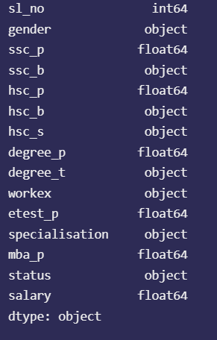
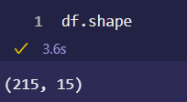
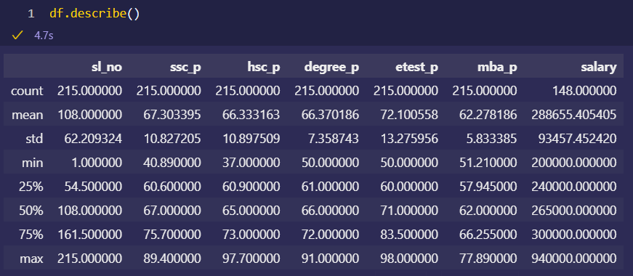
Understanding data

Slide 6
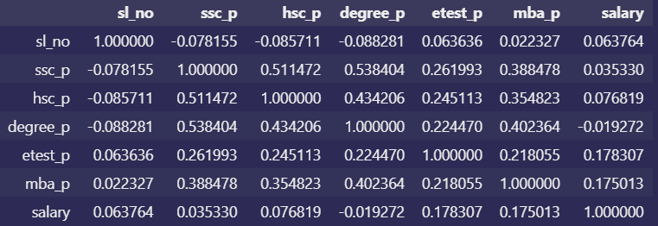
Correlation

Slide 7
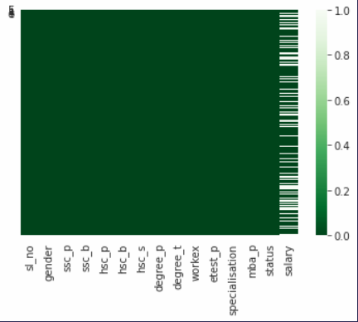
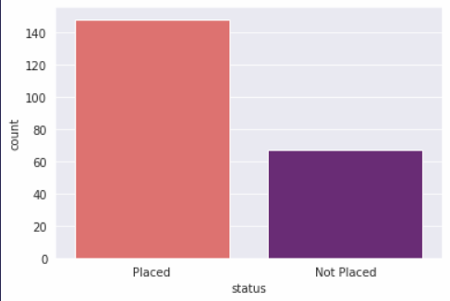
Various graphs to understand dataset better

Slide 8
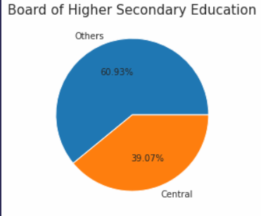
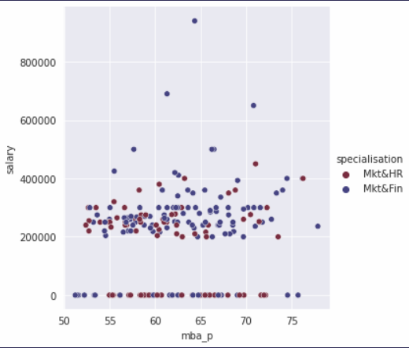
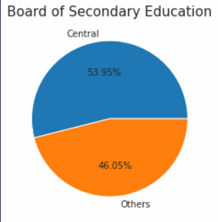

Slide 9
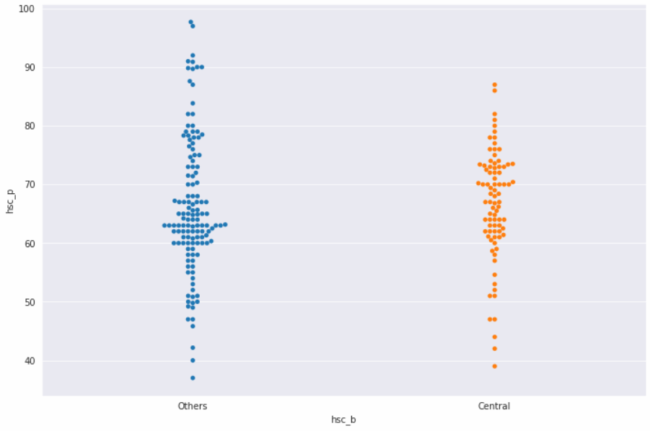
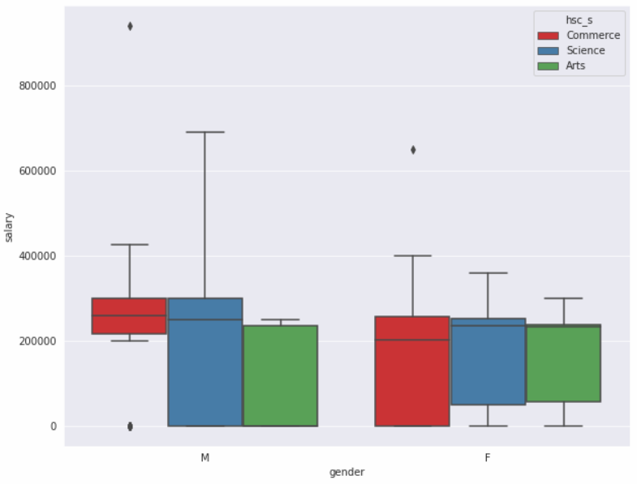

Slide 10
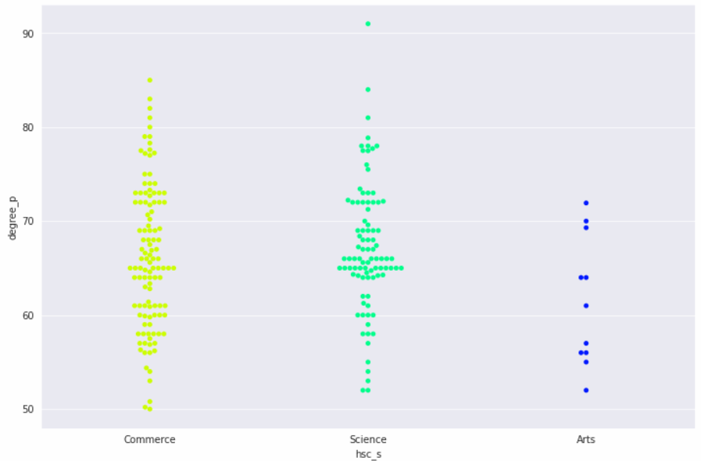
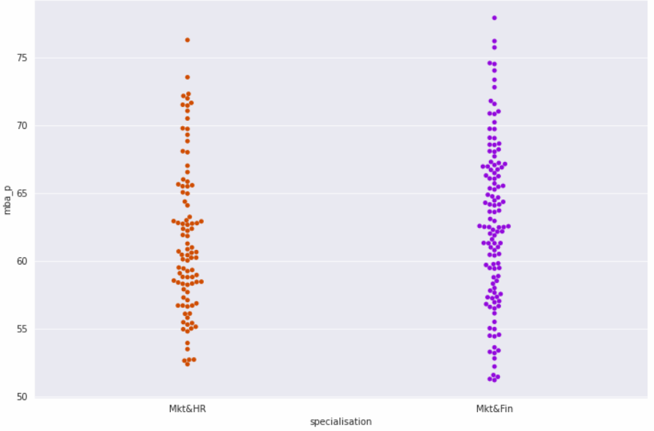

Slide 11
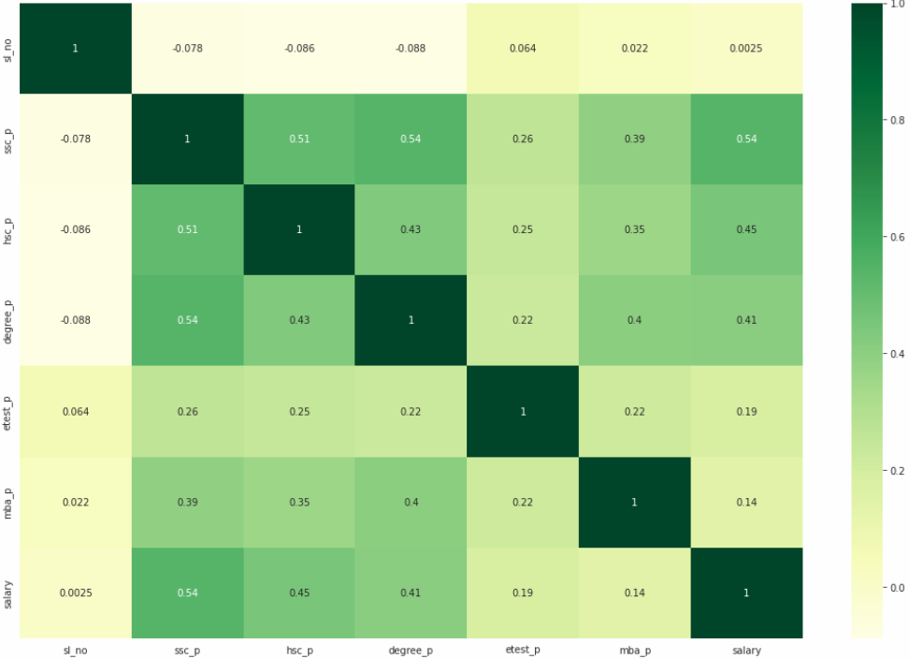
Heat map

Slide 12
What we have done?
Discussed some major columns on which placement depends.
Handling outliers of diagnosis columns. As, it is very important because at last we're predicting placement of a student.
Then I used different Regression models present in sklearn to train the model.
Use Correlation coefficients to measure how strong a relationship is between two variables.

Slide 13
LIBRARIES NEEDED
Numpy
pandas
seaborn
matplotlib
scikit-learn

Slide 14
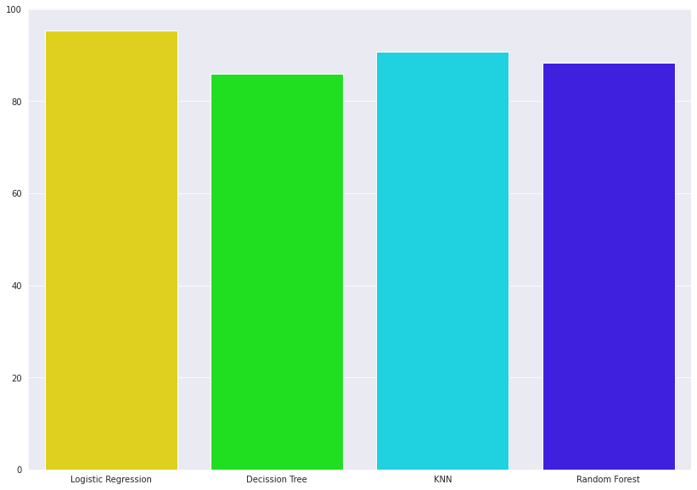
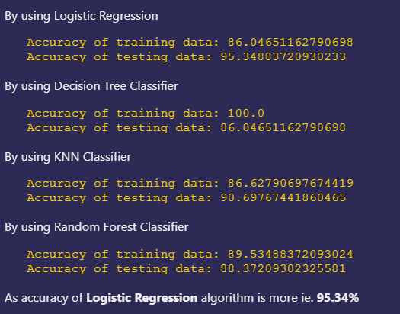
Comparisons of Accuracies for different models

Slide 15
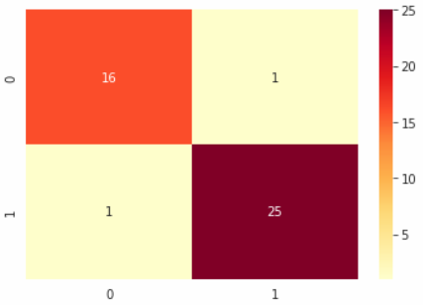
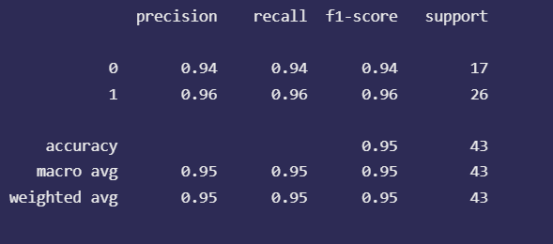
Various Evaluation metrics for logistic regression
Classification report
Confusion matrix

Slide 16
Conclusion
Comparing all those scores scored by the machine learning algorithms, it is clear that Logistic Regression is having the upper hand in case of this dataset
After this, we can use KNN algorithm, which are also having good score as compared to the other algorithms.

Slide 17
Thank you

